Slide 1
Chapter 4 – Repetition & Loops
printf("Hello world!\n");
printf("Hello world!\n");
printf("Hello world!\n");
printf("Hello world!\n");
printf("Hello world!\n");
printf("Hello world!\n");
printf("Hello world!\n");
printf("Hello world!\n");
printf("Hello world!\n");
printf("Hello world!\n");
printf("Hello world!\n");
printf("Hello world!\n");
printf("Hello world!\n");
printf("Hello world!\n");
printf("Hello world!\n");
printf("Hello world!\n");
printf("Hello world!\n");
printf("Hello world!\n");
printf("Hello world!\n");
printf("Hello world!\n");
int i;
for (i = 0; i < 20; i++) {
printf("Hello world!\n");
}

Slide 2
Example 1
What if we want to process three different pairs of integers?
Notes:
If we have a program that reads two numbers and prints out the sum, how do we modify the program so that it will read three pairs of numbers and print out the three sums?

Slide 3
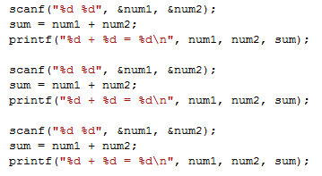
Example 2
One solution is to copy and paste the necessary lines of code. Consider the following modification:
What if you wanted to process four sets? Five? Six? ….
Notes:
We could copy the read, compute, and print instructions two times and that would satisfy the requirements. What would we need to do if we wanted to process more than three sets?

Slide 4
Processing an arbitrary number of pairs
We might be willing to copy and paste to process a small number of pairs of integers but
How about 1,000,000 pairs of integers?
The solution lies in mechanisms used to control the flow of execution
In particular, the solution lies in the constructs that allow us to instruct the computer to perform a task repetitively
Notes:
We could again perform multiple copies but what if the number of sets we wanted to process was large? What if we had hundreds, thousands, or even millions of sets?
Obviously, the copy-paste method would not work very well. We need a method so that we can control the execution flow so that we can perform the same set of instructions repetitively until we have performed them the number of times that we wish.

Slide 5
Repetition (Looping)
Use looping when you want to execute a block of code several times
Block of code = Body of loop
C provides three types of loops
while statement
Most flexible
No ‘restrictions’
for statement
Natural ‘counting’ loop
do-while statement
Always executes body at least once
1
2
3
Notes:
Repetition or looping allows us to execute a block of code, also called the body of the loop, multiple times. C provides 3 types of repetition or looping instructions.
The while statement is the most flexible and so we will cover it first. The for statement allows a more compact method of specifying a counting loop. The do-while is similar to the while but the block of code is always executed at least once.

Slide 6
The while Loop
Repetition structure
Programmer specifies
Condition under which actions will be executed
Actions to be repeated
Psuedocode
While there are more items on my shopping list
Purchase next item and cross it off my list
while loop is repeated
As long as condition is true
Until condition becomes false
Notes:
When using any of the repetition structures, the programmer must specify the condition which if true the actions will be executed and the actions to be repeated. If we had some psuedocode, English-like instructions, that described the process of shopping at Wal-Mart, it might say “While there are more items on my shopping list, purchase the next item and cross it off the list.” While the condition “more items on list” is true, we perform the two actions, purchase next item and cross it off the list.
The while loop is repeated as long as the condition is true. Another way of saying the same thing is that the while loop is repeated until the condition becomes false.

Slide 7
The while Loop
The condition is tested
If the condition is true, the loop body is executed and the condition is retested.
When the condition is false, the loop is exited.
false
condition
true
loop body
next stmt
Notes:
If we look at the flowchart for the while statement, we see that the first thing that is done is that the condition is tested. If the condition is true, the body of the loop is executed and then we go back and retest the condition. If the condition is false, we go to the next statement after the while statement.

Slide 8
The while Loop
1
Syntax:
while (expression)
basic block
Expression = Condition to be tested
Resolves to true or false
Basic Block = Loop Body
Reminder – Basic Block:
Single statement or
Multiple statements enclosed in braces
Notes:
Looking at our first C repetition structure, the while statement, it starts with the keyword while followed by an expression enclosed in parentheses. After that is a basic block.
The expression enclosed in parentheses is our condition that we are going to test to see if the body of the loop will be executed so it needs to resolve to true or false. The basic block is the loop body that will be executed if the condition is true. The basic block can be a single statement or multiple statements enclosed in braces.

Slide 9
Loop Control Variable (LCV)
The loop control variable is the variable whose value controls loop repetition.
For a while loop to execute properly, the loop control variable must be
declared
initialized
tested
updated in the body of the loop in such a way that the expression/condition will become false
If not we will have an endless or infinite loop
Notes:
Many times when controlling a loop, we have a loop control variable, a variable whose value will determine whether the body of the loop will be executed. Like any variable, it has to be declared before it can be used. Before it is used in the conditional expression, it should be initialized. It can then be tested in the condition and if the condition is true, the body of the loop will be executed. The body of the loop then must update or modify the LCV in some way so that the condition will become false and the loop will end. If not, we will have an endless or infinite loop.

Slide 10
Counter-Controlled Repetition
Requires:
Counter variable , LCV, initialized to beginning value
Condition that tests for the final value of the counter (i.e., whether looping should continue)
Constant increment (or decrement) by which the control variable is modified each time through the loop
Definite repetition
Loop executes a specified number of times
Number of repetitions is known
Notes:
Sometimes you wish to execute a block of instructions a set number of times. This requires a counter LCV. It is initially set to a beginning value. The condition tests the counter for a final value. The body of the loop increments or decrements the counter by a constant amount each time it is executed. Because we specify the beginning value, the ending value, and how much it will be modified with each execution, we have specified the number of times the body will be executed which we can easily compute.
Let’s write a program that will display Go Tigers 100 times:
// ch04While1 leave out display of count
// Add display of n
// Change to display of n+1
// ch04While2 from ch04While1 – start count at 1,
leave condition, display n
// Change condition to <=
// ch04While3

Slide 11
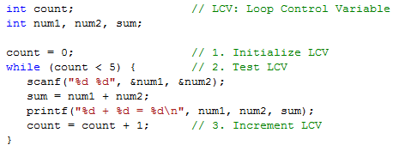
Example 3
Execution Chart
count count<5 repetition
0 true 1
1 true 2
2 true 3
3 true 4
4 true 5
5 false
Notes:
Let’s now modify our program that reads sets and prints sums to handle five sets. We define a LCV called count. Before the loop, it is initialized to zero. The while statement tests the count for less than the final value, five. The body of the loop has our original three statements and it also has a statement that increments count by one.
If we followed the execution of this code, count would have a value of 0, 1, 2, 3, 4, and then 5. At 5, it is no longer less than 5. The body of the loop has been executed 5 times. So, we can start the LCV out at zero, and then our test can be LCV < total-count. We could have also started the LCV out at one and then our test would be LCV <= total-count.

Slide 12
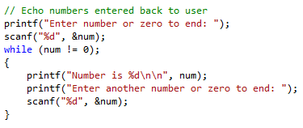
Loop Pitfalls
Enter number or zero to end: 2
What is wrong with my program? It just sits there!
Notes:
Here is a program that should echo back numbers entered by a user but it has a problem. When we run the program, we are prompted for the first number. Upon entering a value of 2, the program stops responding and just sits there – no more program prompts and no Unix command prompt. What is the problem?

Slide 13
Loop Pitfalls: Misplaced semicolon
Notice the ‘;’ after the while condition!
Body of loop is between ) and ;
Result here: INFINITE LOOP! Ctrl-c = Kill foreground process
Do not place semi-colon here!
Notes:
If we look at the while statement, we see that there is a semi-colon at the end of the statement. This creates an empty or null statement block between the while condition and the semi-colon. The value of 2 was entered and since the value of the num variable does not change inside of the loop which is empty, the result is an infinite or endless loop.
In Unix, you can press ctrl-c to kill the foreground process which is your running program. This will get you back to the Unix command prompt.
Before we get to the next looping statement, let’s write a program that will add up numbers divisible by 5 to some number that the user enters. We will use a while counting loop like and then our new for counting loop.
// ch04Sum5s leaving out using for

Slide 14
The for Loop
A natural 'counting' loop
Steps are built into for structure!
Initialization
Loop condition test
Increment or decrement
initialization
false
condition
true
loop body
…
increment
next stmt
Notes:
When we took a look at a while loop with a counter LCV, we were using a counter to control the number of repetitions of the loop body. The for statement allows us to specify the major steps of a counting loop in one structure. A counting loop begins with the initialization of the counter LCV. Before the body of the loop, a condition is tested. If it is true, the loop body is executed including an increment of the counter variable.

Slide 15
Review: Assignment Operators
Statements of the form
variable = variable operator expression;
can be rewritten as
variable operator= expression;
Examples of assignment operators:
a += 5 (a = a + 5)
a -= 4 (a = a - 4)
b *= 5 (b = b * 5)
c /= 3 (c = c / 3)
d %= 9 (d = d % 9)
Notes:
Remember that anytime you have an assignment that is of the form variable = variable operator expression, this can be written in a shorter equivalent form of variable operator = expression. For example, a = a + 5 can be written a += 5.

Slide 16
Review: Pre-increment operator
Pre-increment operator: ++n
i) Stand alone: add 1 to n
If n equals 1, then after execution of the statement
the value of n will be 2.
ii) In an expression: Add 1 to n and then use the new value of n in the expression.
If n is initially 1, the above statement will print the value 2.
After execution of printf, n will have the value 2.
Notes:
Also remember that when adding or subtracting one, we can use pre or post increment or decrement operators. Placing a ++ before a variable will add one to the value of the variable before the variable is used in the expression. In the first example shown here, one is added to n but since it is a stand-alone statement, the value is not used any further. In the second example, if n has a value of one, one is added to n and then the new value, 2, is used for the printf.

Slide 17
Review: Post-increment operator
Post-increment operator: n++
i) Stand alone: add 1 to n
If n equals 1, then after execution of the statement
the value of n will be 2.
ii) In an expression: Use the value of n in the expression and then add 1 to n.
If n is initially 1, the above statement will print the value 1 and then add 1 to n. After execution, n will have the value 2.
Notes:
Post-increment can yield different results than pre-increment. In the first example, the value of n is not used since this is a stand-alone statement but then one is added to n. This performs the same results as a pre-increment.
In the second example, if n has a value of 1, the value of 1 is used in the printf and then one is added to n. Using pre-increment, we printed the number 2 but using post-increment, we printed the number 1. In both cases, the value of n after the printf is 2.

Slide 18
Pre- and Post-decrement operator
Pre- and post-decrement operators, --n, n-- , behave in a similar manner
Use caution when using in an expression
Do not use unless you know what you are doing!
Notes:
Using pre and post decrement has the same differences. When using pre and post increment or decrement in an expression that is not a stand-alone statement, be aware of when the increment or decrement will take place. Shortcut expressions and pre or post increment or decrement are often used in the for statement to perform the increment or decrement that takes place at the end of the loop body. In this case, it is a stand-alone statement.

Slide 19
The for Loop
2
Syntax:
for (initialization; test; increment)
basic block
Notes:
In our second C repetition structure, the for statement begins with the keyword for and then within parentheses are three parts separated from each other by semi-colons. After that comes the basic block making up the loop body.
The first part is the initialization statement or statements. This is generally used to initialize the counter variable.
The second is the test conditional expression that specifies the condition under which the loop body will be executed. This generally tests the counter for the final value.
The third is a statement or statements that are to be performed after the loop body. This generally increments or decrements the counter variable.
If the first part and/or the third part contain multiple statements, they are separated by commas.

Slide 20
for Loop Example
Prints the integers from one to ten
Notes:
Here we have a for loop that prints the numbers one through ten. The for statement initializes the counter variable to 1, repeats the loop body as long as the counter is <= 10, and increments the counter by one after each execution of the loop body. This is the same as the while counting loop shown below it. In that code, the initialization, test, and increment are separate statements.
<ch04For1.c from ch04While1>
<ch04For2.c from ch04While2>

Slide 21
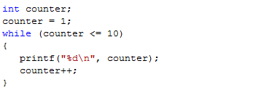
for vs while
Prints the integers from one to ten
Notes:
Here we have a for loop that prints the numbers one through ten. The for statement initializes the counter variable to 1, repeats the loop body as long as the counter is <= 10, and increments the counter by one after each execution of the loop body. This is the same as the while counting loop shown below it. In that code, the initialization, test, and increment are separate statements.
<ch04For1.c from ch04While1>
<ch04For2.c from ch04While2>

Slide 22
for Loop Example
How many times does loop body execute?
Notes:
Now that you have seen one for loop, can you determine how many times this loop body will be executed?
Let’s go back to our program that sums the numbers that are evenly divisible by 5 and add a for loop to do the same thing as the while.
// ch04Sum5s – add using for

Slide 23
for Loop Example
How many times does loop body execute?
Bite 1 -- Yum!
Bite 2 -- Yum!
Bite 3 -- Yum!
Notes:
Three times: Count will have a value of 0, 1, 2, and then when it becomes 3, the loop will end.

Slide 24
The do-while Loop
The do-while loop is similar to the while loop
Condition for repetition tested after the body of the loop is executed
loop body
All actions are performed at least once!
true
condition
false
Notes:
Our last C repetition structure is the do-while which is similar to the while structure but the condition is tested after the loop body rather than before. It is a post-test loop rather than a pre-test loop like both the while and the for structures. The major implication of the moving of the condition test is that the body of the loop will be executed at least once.

Slide 25
The do-while Loop
3
Syntax:
do {
statements
} while ( condition );
Notes:
The third C repetition structure begins with the keyword do. That is followed by a basic block enclosed in braces. The basic block is followed by the keyword while and then the condition enclosed in parentheses.

Slide 26
The do-while Loop
Example
Prints the integers from 1 to 10
Notes:
Here is a do-while that prints the numbers one through ten. It is equivalent to using a while or a for to do the same thing.

Slide 27
The do-while Loop
Example
Makes sure that the user enters a valid weight
Notes:
This is an example of how we can use the post-test to our advantage. The user is prompted to enter a positive weight and then the weight is read. This will continue as long as the value entered by the user is not a positive number.

Slide 28
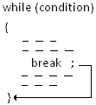
The break Statement
break
Causes immediate exit from a while, for, do/while or switch structure
We will use the break statement only to exit the switch structure!
Notes:
It is possible to use the same break statement that we saw in the switch statement in one of our C repetition structure loop bodies. It will cause execution to break out of the loop and go to the next statement after the loop. This is considered bad programming practice because it is harder to determine how you arrived at that next statement. For that reason, we will only be using the break statement in the switch structure.

Slide 29
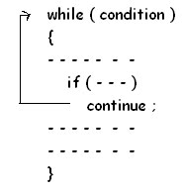
The continue Statement
continue
Control passes to the next iteration
We will not use the continue statement!
Notes:
There is also a continue statement that causes execution to go to the next iteration of the loop. This is also considered a bad programming practice so we will not use the continue statement.

Slide 30
Looping Subtasks
We will examine some basic algorithms that use the while and if constructs. These subtasks include
Reading unknown quantity of data
Counting things
Accumulating (summing) totals
Searching for specific values
Finding extreme values
Notes:
Now that we know how to make decisions and perform repetitions, we can use these for some common subtasks within a program. These subtasks include reading until there is no more data, counting, accumulating, searching, and finding extremes.

Slide 31
Looping Subtasks
Examples will be based upon common models: Priming Read or Input Count
The type of state that must be maintained by the program depends on the nature of the problem and can include:
indicator (true/false) variables
counter variables
sum variables
previous input value variables
Initialize program state
Read the first value (priming read)
While (data exists)
update program state as needed
read next value(s)
Output final state
Initialize program state
While (input count OK)
update program state as needed
Output final state
Notes:
All of our looping subtasks will be based on common models. In the first model, we perform some initialization including an initial or priming read to set up for the loop. Then while we have data to process, we process that data, and at the end of the loop we read some more data. After the loop has finished, we can output results if need be.
The second model does not have a priming read, instead the read or scanf is done in the condition of the looping statement and the returned input count is tested to make sure the data was read.
For variables, we might need true-false indicators, counters, sums, and previous input values.

Slide 32
Counter-Controlled Repetition
Number of items is known before loop
Suppose the problem becomes:
Develop a class-averaging program that will process an arbitrary number of grade scores each time the program is run.
Notes:
We’ve already seen how we can use a counter to control how many times a loop is executed. If we know the number of items that we would like to read, we can use a counter-controlled loop to control how many items are to be read. In this example, we wish to read 5 integer test scores and display them. We can use a for loop to vary a counter from 1 through 5. Inside the loop, we read and display a test score.
If we then wanted to process sets of 10 test scores, 20 test scores, and 30 test scores, we would need to modify the program each time.
How could we write a program that would process an arbitrary number of scores each time the program is run so that we don’t have to modify the program each time we have a new set of scores?

Slide 33
Sentinel-Controlled Repetition
One way to handle an arbitrary number of input values is to have the user enter a special value to indicate the end of input.
Such a value is a sentinel value.
Indicates end of valid input
Loop ends when sentinel value is read
Must choose a sentinel value that cannot be confused with a regular input value.
25
43
67
96
12
58
44
-1
Notes:
One way that we can do this is to have a special value called a sentinel that indicates the end of the input. The sentinel is not part of the data that we wish to process, it just signals that there is no more data to process. We want our loop that processes the data to end when the sentinel is read. Because we don’t want to confuse the sentinel with our data, it has to be a special value that would not be in the normal range of our input data.
In the input data shown here, we have a set of positive integers that is ended by a sentinel of negative one.

Slide 34
Sentinel-Controlled Priming Read
For sentinel-controlled loops
Read before the loop (priming read)
Test input to make sure it is not the sentinel value
Process
Read again at the bottom of the loop
Use the following model:
read before entering the loop
while (value_read != SENTINEL)
{
// process
…
read at bottom of loop
(before entering loop again)
}
Loop
Notes:
To process a set of data ending in a sentinel, we want to loop through the data until the sentinel is reached. With the priming read model, before the loop, we must read the first value. This read that sets up the loop is called a priming read. The loop then tests to see if the sentinel has been read, processes the data, and lastly reads another value.
If we look at this general model again, we can see those steps
Priming read
Test in repetition statement to loop as long as value read is not sentinel
Process read data
Subsequent read at end of loop

Slide 35
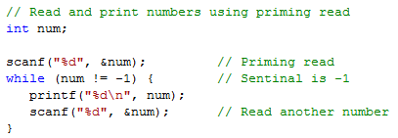
Sentinel-Controlled Loop using Priming Read
25
43
67
96
12
58
44
-1
Notes:
To write a program to read and print a set of numbers, we start with a variable to hold each number. Before the loop, we have a priming read to read the first number. Our while statement says to execute the body of the loop as long as the number read is not the sentinel so the while loop will stop after the sentinel is read. The body of the loop consists of a statement to print the number read and then a statement to read the next number.

Slide 36
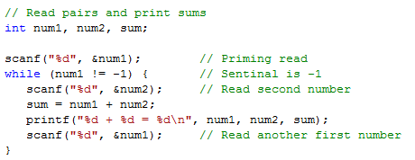
Example of sentinel-controlled loop
25 43
67 96
12 58
44 99
-1
Notes:
Let’s go back to our program where we were reading pairs of numbers. We want to read numbers until the first number read is the sentinel and print out the sums of the pairs. Therefore, our priming read just reads the first number of the first pair. The while statement says to execute the loop as long as the first number is not the sentinel. In the body of the loop, we read the second number, compute and print the sum, and lastly read another first number from the next pair.

Slide 37
Processing an arbitrary number of pairs
Sometimes it is not possible to find a sentinel value
We can use
End-of-input controlled loops
Uses return from scanf
Can be fooled by invalid data
End-of-file controlled loops
Uses function feof
Notes:
Sometimes it is not possible to find a value that can act as a sentinel. Suppose we wanted to be able to process all integers, not just positive integers. There are two ways that we can do this in C.
To detect the end of the data, we could use the return value from scanf or
we could use the feof function.
When using the return from scanf, if we are trying to read numbers and there is some alphabetic data, using the return from scanf could be fooled into thinking that there is no more data and we wouldn’t know that there is bad data.

Slide 38
End of Data
End-Of-File
Keyboard
Ctrl-d (sometimes does not work on Mac!)
25 43
67 96
12 58
44 99
Ctrl-d
The End Is Here!
Notes:
When we try to read, we need to detect that there is no data to read. This condition is called end-of-file. When reading from the keyboard, you can use ctrl-d to indicate that there is no more data. This does not work under the terminal window on some Mac operating systems.

Slide 39
Redirection
Redirection: Read / Write to actual file
stdin: cmd < input-file
Ex: ./a.out < nums.txt
stdout: cmd > output-file
Ex: ./a.out > report.txt
stdout (append): cmd >> output-file
Ex: ./a.out >> report.txt
Both: cmd < input-file > output-file
Ex: ./a.out < nums.txt > report.txt
Leave out prompts when designing for redirection
Notes:
You can use redirection to specify that standard input is to actually come from a file. When you wish to run your program, you specify the command to run the program, a less than sign (or left arrow), and then the file to which you wish to redirect stdin. Whenever your program executes a scanf, reading from standard input, the input will come from the file. In the example shown, the program a.out is run and stdin is redirected to nums.txt.
You can also redirect standard output to a file. You specify the command to run the program, a greater than sign (or right arrow), and then the file to which you wish to redirect stdout. The example shows a.out being run and stdout redirected to report.txt. The file report.txt will either be created or written over. You can also append to a file by specifying two greater than signs. In this case, the file will be added to if it exists or a new file will be created.
You can also do both on the same command line.

Slide 40
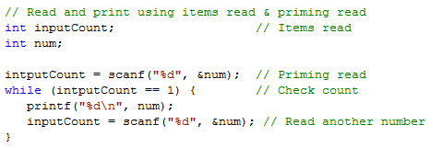
Example: End-of-input controlled loop using items read & priming read
25
43
67
96
12
58
44
endOfData.c can run it with ctrl-d or redirect input.txt
Notes:
When you design a program to be used with redirection, you should leave out the prompts. The data is coming from a file, not from the terminal.
Here is a program to read and print numbers using the return from scanf and a priming read. We have another variable called inputCount to hold the scanf return. The priming read tries to read a number and the number of items read is placed into the variable. We want to process numbers as long as the number of items read is one. At the end of the loop, we have another read which saves the input count.
Another example: ~/111/Chp4/endOfData.c can run it with ctrl-d as well as with redirected input.txt

Slide 41
Example: End-of-input controlled loop using just items read
25
43
67
96
12
58
44
endOfData2.c can run it with ctrl-d or redirect input.txt
endOfData3.c can run it with ctrl-d or redirect input.txt
Notes:
~/111/Chp4/endOfData2.c for first example
~/111/Chp4/endOfData3.c for second example with EOF
Test both with user input and ctrl-d and also with redirecting input.txt

Slide 42
Example: End-of-input controlled loop using number of items read
25 43
67 96
12 58
44 99
endOfData4.c with redirected input.txt &
input2.txt (has extra number)
Notes:
Here is our program to read and sum pairs of numbers checking the return from scanf inside the while test. We want to process pairs as long as the number of items read is two. This program would also end if there were one extra number at the end of the data.
~/111/Chp4/endOfData4.c. with redirected input2.txt (has extra number in file)

Slide 43
Detecting End-of-File
Function: feof
Syntax: feof(file-pointer)
Returns true or false
Standard input: feof(stdin)
Use in a while loop -
while (!feof(stdin))
Notes:
To detect end-of-file with the feof function, you specify feof and then a file-pointer as the argument. It returns a true or false which can then be tested in your program. To use for standard input, you would specify feof and then stdin as the argument.
In a program if you wished to execute a loop as long as you had not reached end-of-file, you could specify !foef(stdin) as the condition in your while statement.

Slide 44
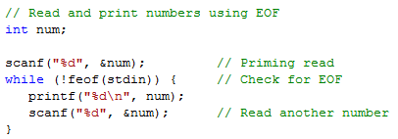
Example: End-of-file controlled loop
25
43
67
96
12
58
44
End of File
Notes:
Here is a program to read and print numbers using the feof function. The priming read tries to read a number. We want to process numbers as long as the end-of-file was not reached. At the end of the loop, we attempt another read.

Slide 45
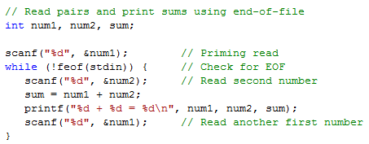
Example: end-of-file controlled loop
25 43
67 96
12 58
44 99
End of File
endOfData5.c can run it with ctrl-d or redirect input.txt
Notes:
Here is our program to read and sum pairs of numbers using the feof function. The priming read tries to read the first number in the first pair. We want to process data as long as we have not reached end-of-file. Inside the loop, we read and process the second number of the pair. At the end of the loop, we have another attempted read of the first number of the pair.
~/111/Chp4/endOfData5.c. with redirected input.txt. (doesn’t work with user input without using ctrl-d, but works with redirected input file)

Slide 46
Looping Subtask: Counting
Example: Find the number of scores in a file
Here the program state that must be maintained is a counter that maintains the number of scores that have been read so far.
Steps
Declare an int variable for the count
… then what?
Notes:
Many programs need to keep a count of the number of some item or condition, for example, the number of scores in a file. Here we have to have a counter variable that keeps track of how many scores we have read so we define an integer variable for the count. It also needs to be given an initial value of zero. In the body of a loop as we are reading the scores, we increment the counter. Counters are incremented by a constant amount.

Slide 47
Looping Subtask: Counting
Example: Find the number of scores in a file
Here the program state that must be maintained is a counter that maintains the number of scores that have been read so far.
Steps
Declare an int variable for the count
Initialize the count to zero
… then what?
Notes:
Many programs need to keep a count of the number of some item or condition, for example, the number of scores in a file. Here we have to have a counter variable that keeps track of how many scores we have read so we define an integer variable for the count. It also needs to be given an initial value of zero. In the body of a loop as we are reading the scores, we increment the counter. Counters are incremented by a constant amount.

Slide 48
Looping Subtask: Counting
Example: Find the number of scores in a file
Here the program state that must be maintained is a counter that maintains the number of scores that have been read so far.
Steps
Declare an int variable for the count
Initialize the count to zero
Increment the count in the body of the loop
Notes:
Many programs need to keep a count of the number of some item or condition, for example, the number of scores in a file. Here we have to have a counter variable that keeps track of how many scores we have read so we define an integer variable for the count. It also needs to be given an initial value of zero. In the body of a loop as we are reading the scores, we increment the counter. Counters are incremented by a constant amount.

Slide 49
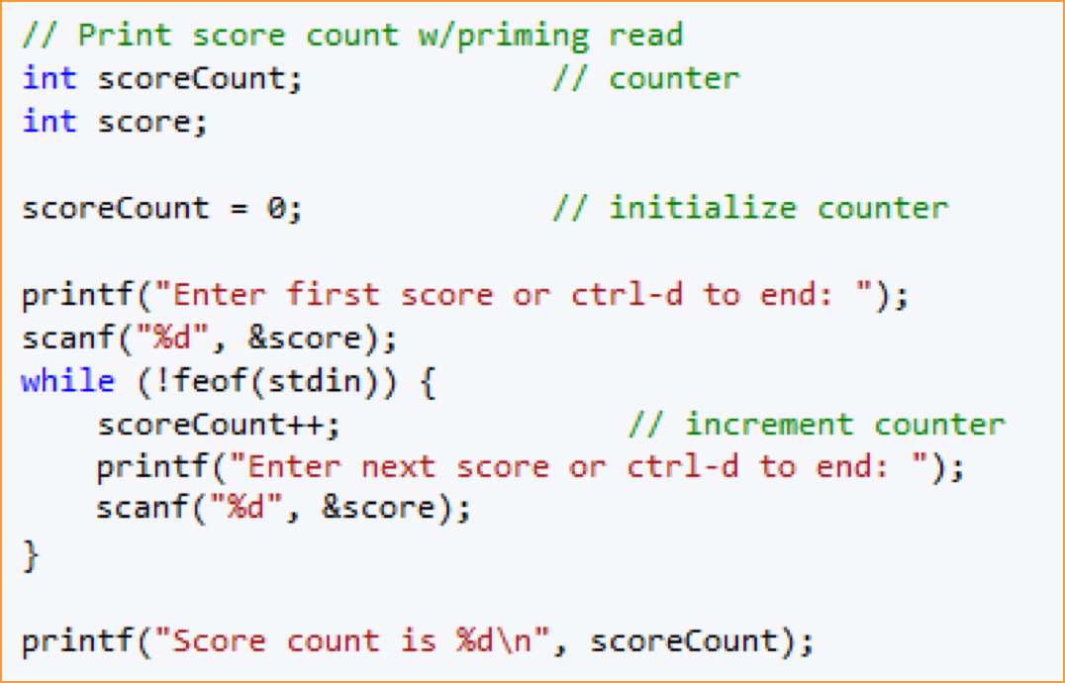
Looping Subtask: Counting
counting.c using input from keyboard with ctrl-d to quit
counting2.c with redirect from file input3.txt
(changed printf’s)
Notes:
~/111/Chp4/couting.c using input from the keyboard
The variable called scoreCount is being used as the counter; it’s initialized to zero.
The program uses a priming read.
The loop reiterates as long as the read has not hit end-of-file.
The loop body increments the counter because there has been a successful read of a score. It then reads the next score.
After hitting end-of-file, we can print the score count.
How would you change if designed to read from a file?
Comment out the printf statements that prompt the user; possibly add printf statements to print the scores that were read in.
~/111/Chp4/couting2.c using input redirected from file input3.txt

Slide 50
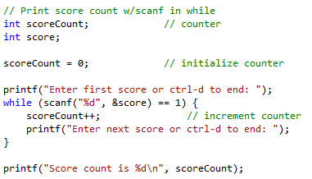
Looping Subtask: Counting
counting3.c using input from keyboard with ctrl-d to quit
Notes:
~/111/Chp4/couting3.c
Here we have eliminated the priming read and are using the return from the scanf in the while condition.

Slide 51
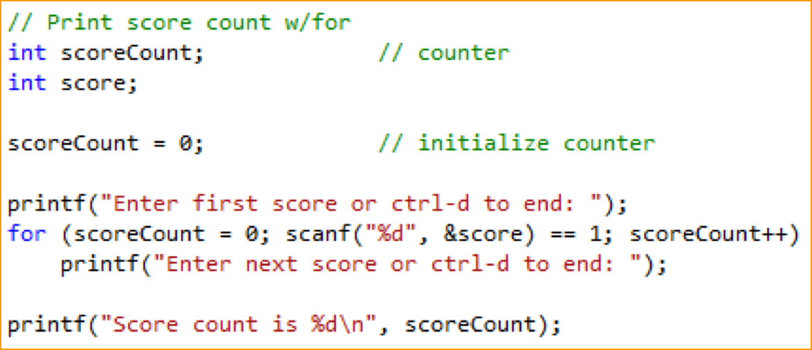
Looping Subtask: Counting
counting4.c using input from keyboard with ctrl-d to quit
counting5.c using redirect with input3.txt, input4.txt, or
input5.txt
Notes:
Since we are using a counting loop, why not use a for?
~/111/Chp4/couting4.c
- - > counting4.c doesn’t initialize the LCV in the for loop because it’s already initialized above the for loop
How would this be modified for reading from a file?
Remove prompting printf statements; add printf statements to show the scores that are read in from file
~/111/Chp4/couting5.c

Slide 52
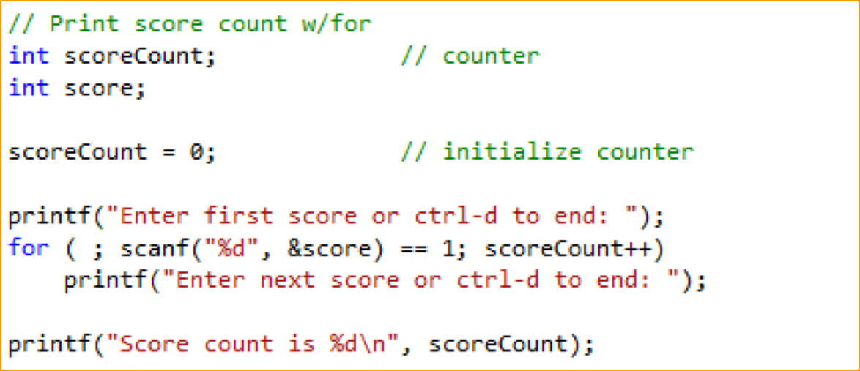
Looping Subtask: Counting
Same slide as previous one, except for the semi-colon in the first part of the for loop.
Since the LCV was already initialized, you can just put a semi-colon for the first part of the for loop.
(counting4.c and counting5.c mentioned on previous slide both do this)

Slide 53
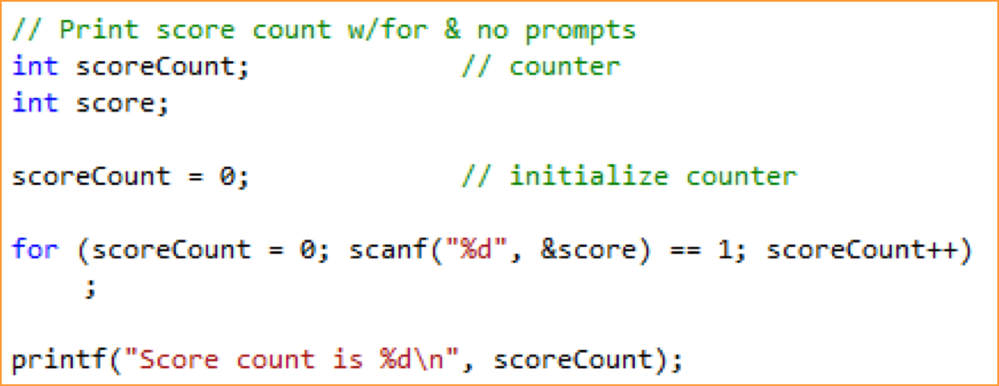
Looping Subtask: Counting
counting6.c shows the empty for loop; uses the value of the LCV as
the count and doesn’t do anything else inside the for loop
Notes:
~/111/Chp4/couting6.c - - > shows empty for loop, uses the value of the LCV as the count and doesn’t do anything else inside body of loop

Slide 54
Counting Example
What if we want to print the number of passing scores (scores >= 70)?
We need a mechanism that allows us to count only if the score is greater than or equal to 70
Use if stmt
Notes:
Suppose we only wanted to print the count of the passing scores that are greater then or equal to 70. We only want to count the passing scores so we can use an if statement just before we increment the count.

Slide 55
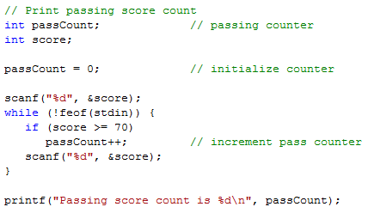
Looping Subtask: Counting
passing.c using redirect with input3.txt, input4.txt, or
input5.txt
Notes:
Here we’ve changed scoreCount to passCount and inserted the if statement just before the increment for the counter so that only scores >= 70 will be counted.
~/111/Chp4/passing.c - - > added a printf to show all the scores read in from the file, input4.txt

Slide 56
Counting Example
What if we want to print the number of passing scores (scores >= 70) and the number of failing scores?
Use if -else
Notes:
Suppose we wanted to count the passing and the failing scores. We could use an if-else.

Slide 57
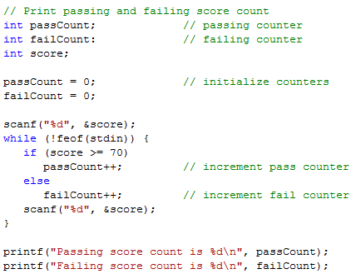
Looping Subtask: Counting
passing2.c using redirect with input3.txt, input4.txt,
or input5.txt
Notes:
We now have separate counters for passing scores and failing scores which are both initialized. We’ve also added an else to the if to count the failing scores. Lastly we also output the failing score count.
~/111/Chp4/passing2.c

Slide 58
Looping Subtask: Accumulation (Summing)
The state that must be maintained is the sum of all values that have been seen so far.
Declare a variable to hold the sum (accumulator)
Initialize the sum to zero
In the body of the loop, add the new value to the sum
Notes:
Sometimes we want to maintain a sum or total of some values in a looping program. To do that we declare an accumulator variable to hold the sum and we also need to initialize it to zero. In the body of the loop, we add the value to the sum.

Slide 59
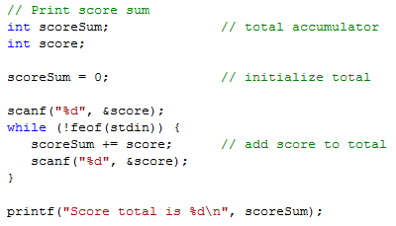
Accumulating Example
sum.c using redirect with input4.txt
Notes:
Here we have a score accumulator called scoreSum instead of a counter. It is also initialized. Inside the loop, the score just read is added to the accumulator. At end-of-file, the total is printed.
~/111/Chp4/sum.c with input4.txt

Slide 60
Counting & Accumulating Example
Problem
A class of ten students took a quiz.
The grades (integers in the range 0 to 100) for this quiz are available to you.
Determine the class average on the quiz.
Hint: Requirements for an average
Count of number of items
Sum of the items
Notes:
Suppose we have ten quiz grades that range from 0 to 100 to be entered by the user. How would you determine the class average?
To help you out: To compute an average, we need a count of the number of items and the sum or total of the items.

Slide 61
Counting & Accumulating Example
Pseudocode:
Set total to zero
Set grade counter to one
While grade counter is less than or equal to ten Input the next grade Add the grade into the total Add one to the grade counter
Set the class average to the total divided by ten
Print the class average
avg.c using redirect with input5.txt
avg2.c using redirect with input5.txt
Notes:
We can start out by setting the total to zero and the grade counter to one. While the grade counter is <= ten, we can get a grade, add it to the total, and increment the grade counter. Once the counter becomes greater than 10, the loop will end. We could then compute and print the average.
~/111/Chp4/avg.c with input5.txt
Based on what we have learned about detecting end-of-file, how would you change this to average all of the scores in a file?
~/111/Chp4/avg2.c with input5.txt

Slide 62
Looping Subtasks: Searching
Need a variable to indicate whether or not the program has encountered the target value, call it found
Initialize found to 0 (false)
Each time through the loop, check to see if the current value equals the target value
If so, assign 1 to found
Notes:
If you are searching through data and you wish to determine if a target value is found, you can set up an indicator variable that will contain the found status. You could start by initializing it to false or zero. As we loop through the data, if the current value equals our target value, we would change the value of the indicator to true or one.

Slide 63
Searching Exercise
Write a C program that
Reads a target score at the beginning of the file
Reads a set of scores and determines if the target score is in the set of scores
If found prints Target ## was found otherwise prints Target ## was not found
Notes:
How would we write a program that would read a target score from a file and then read the actual scores from the file determining if one is equal to the target? At the end it would tell us if the target is found.

Slide 64
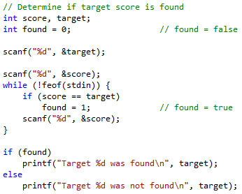
Looping Subtasks: Searching
flag.c using redirect with input5.txt
Notes:
~/111/Chp4/flag.c with input5.txt - - > added a couple of printfs to show what the target score is and then each other score read in from file
We need variables for the input score and the target score. We also need an indicator variable for a found target initially set to false, zero.
Before the loop, we read the target score and then the first score. The loop process scores until end-of-file. Processing involves checking to see if the score is equal to the target. If so, we set the indicator variable to true, one.
At end-of-file, we can print out the appropriate message.

Slide 65
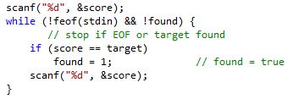
Searching Improvement
Stop searching if target has been found
flag2.c using redirect with input5.txt
Notes:
This code can be improved by stopping the search if the target has been found. The while statement has been improved to loop as long as we haven’t reached end-of-file and we haven’t found the target. It will stop at end-of-file or the target has been found.
~/111/Chp4/flag2.c with input5.txt

Slide 66
Looping Subtasks: Finding Extremes
Finding Extreme Values (e.g. maximum, minimum)
Need a variable (such as maxValue) to remember the most extreme value encountered so far
25
43
67
96
12
58
44
96 is the max
12 is the min
Notes:
For determining extreme values, maximum or minimum, from a set of values, we need a variable to remember the most extreme as we go through the values.

Slide 67
Looping Subtasks: Finding Extremes
Finding Extreme Values (e.g. maximum, minimum)
Initialize the maxValue (minValue) to some value
maxValue: Lower value than any data
minValue: Higher value than any data
Or for both: The first data value
For each data item
Compare the current value to maxValue (or minValue)
If the current value is > maxValue (< minValue), replace maxValue (minValue) with the current value.
Notes:
To perform this subtask, we initialize the most extreme value variable. If we are looking for a maximum value, we could initialize maxValue to a value that would be lower than any value in our data. If we are looking for a minimum value, we can initialize minValue to a value that would be higher than any value in our data. If that is not possible, another method will work in all cases. That method is to initialize the extreme variable to the first data value.
As we are going through the data, if we encounter a value that is more extreme than our current extreme value, we replace the extreme value with the new value. So if we are looking for a maximum and we encounter a value greater than our current maxValue, we set maxValue to that value. If we are looking for a minimum and we encounter a value less than our current minValue, we set minValue to that value.

Slide 68
Extremes Exercise
Write a C program that
Reads a set of scores from a file
Determines and prints the maximum score and the minimum score
Notes:
Suppose that we wished to write a program that would read a set of scores, determine, and print the maximum score.

Slide 69
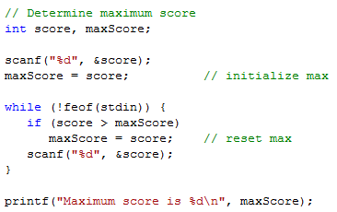
Looping Subtasks: Finding Extremes
extremes.c using redirect with input5.txt
(sets maxScore and minScore to the value of
the 1st score read in)
extremes2.c using redirect with input5.txt
(sets maxScore to 0 and minScore to 100)
Notes:
Here we have a variable named maxScore to hold our extreme maximum value. After the first score is read, it is initialized to that value. In the loop as we go through the scores, if a score is greater than our current maximum, we set maxScore to that new score. After the loop, we have our maximum value.
~/111/Chp4/extremes.c with input5.txt - - > sets maxScore and minScore to the value of the first score read in
~/111/Chp4/extremes2.c with input5.txt - - > sets maxScore to 0 and minScore to 100

